Slide 1
The integrative function of the nervous system
Name
Institutional Affiliation
Course
Date

Slide 2
Introduction and general overview of the presentation
How does peripheral and central nervous systems relate with the sensory organs
The brain and main sensory organ in the head
Autonomous nervous system and the Homeostasis
Disease that causes imbalance of autonomous nervous system
Most important takeaway from this course
Challenging concept to learn
Ways of overcoming the challenge in future

Slide 3
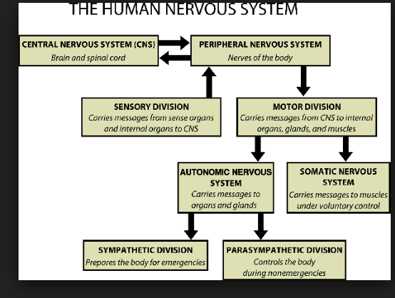
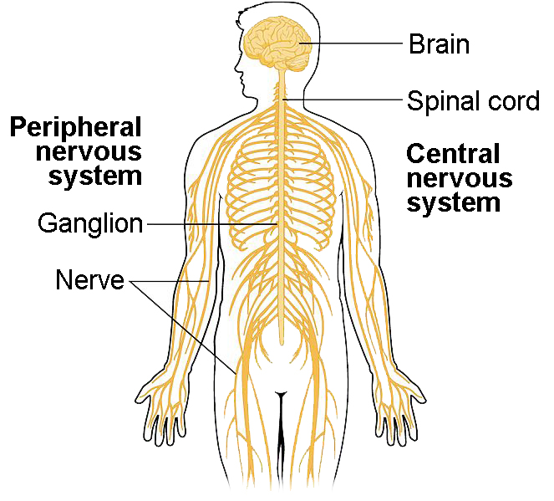
How does peripheral and central nervous systems relate with the sensory organs
The peripheral and the central nervous system functions collectively as major parts of nervous system.
Both parts are also linked to brain by the spinal cord (Chan et al, 2018).
The peripheral nervous system has sensory receptors for processing internal and external environmental changes.
Any information from this part is sent to the central nervous system.
The two parts functions together through the nerves of peripheral nervous system that enter and become part of the central nervous system
Notes:
This slides describes how the peripheral and central nervous systems relate with the sensory organs.
The peripheral and the central nervous system functions collectively as major parts of nervous system.
The both parts are also linked to brain by the spinal cord (Chan et al, 2018).
The peripheral nervous system has sensory receptors for processing internal and external environmental changes.
Any information from this part is sent to the central nervous system.
The two parts functions together through the nerves of peripheral nervous system that enter and become part of the central nervous system

Slide 4
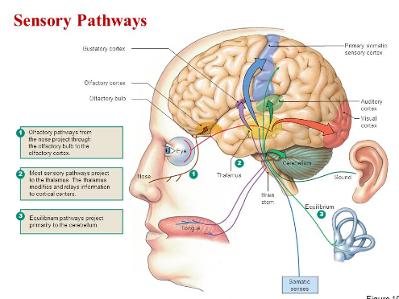
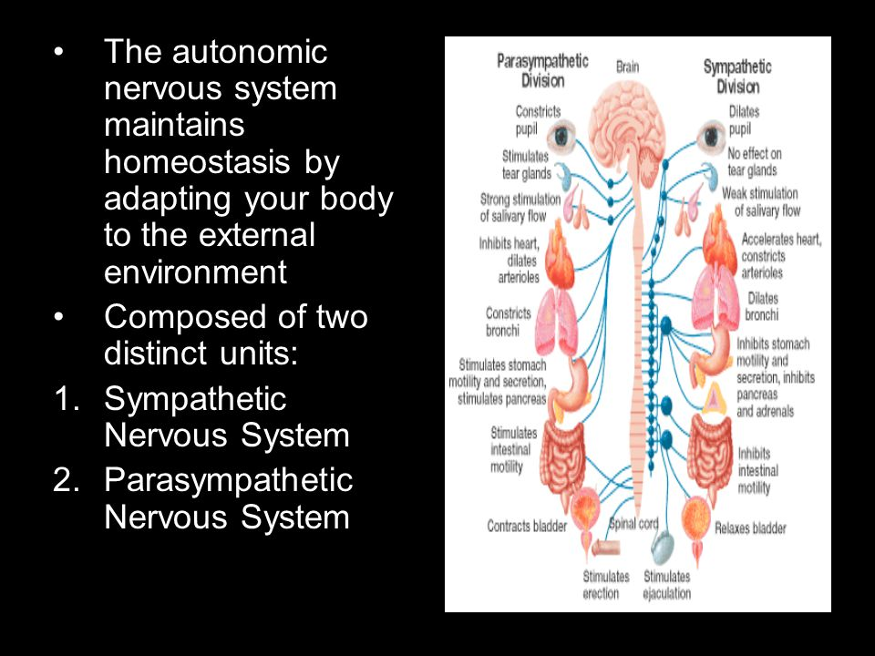
Sensory pathways and homeostasis maintenance by nervous system
The sensory pathways are the routes that coordinates human brain and other sense organs like human ear as seen of the picture on the right hand side.
Nervous system helps in maintaining homeostasis by regulating and controlling other body parts
Any change acts as a stimulus to the receptor that sends nerve impulse to brain regulating center.
It regulate nervous system maintains the homeostasis by helping body in adapting to external environment
Sympathetic and parasympathetic nervous systems are the units of autonomic nervous system.
Notes:
This slide addresses Sensory pathways and homeostasis maintenance by nervous system.
The sensory pathways are the routes that coordinates human brain and other sense organs like human ear as seen of the picture on the right hand side.
Nervous system helps in maintaining homeostasis by regulating and controlling other body parts
Any change acts as a stimulus to the receptor that sends nerve impulse to brain regulating center.
It regulate nervous system maintains the homeostasis by helping body in adapting to external environment
Sympathetic and parasympathetic nervous systems are the units of autonomic nervous system

Slide 5
Explanation of a disease resulting from autonomic nervous system imbalances and most important takeaways in this course
The dysautonomia is an example of illness that can result from imbalance and abnormality function of autonomic nervous system (Autonomic Nervous System Regulates Health, 2018).
The imbalance of ANS affects many involuntary functions
The most important take away from this course is on how the nervous system works with other parts of the body.
Most importantly, the diseases resulting from autonomic nervous system imbalances.
most important takeaways in this course that inform me as future medical profession because there is always a need to control and ensure our bodies a balanced in terms of hormones and activities performed.
The autonomic nervous system imbalances was one conecpt that I found challenging to learn. I overcame this challenge by discovering what n exactly my future carrier requires.
In future I will overcome this challenge by strengthening my own executive function skills and keeping what I learned in a perspective.
Notes:
The dysautonomia is an example of illness that can result from imbalance and abnormality function of autonomic nervous system(Autonomic Nervous System Regulates Health, 2018).
The imbalance of ANS affects many involuntary functions
The most important take away from this course is on how the nervous system works with other parts of the body.
Most importantly, the diseases resulting from autonomic nervous system imbalances.
most important takeaways in this course that inform me as future medical profession because there is always a need to control and ensure our bodies a balanced in terms of hormones and activities performed.
The autonomic nervous system imbalances was one concept that I found challenging to learn. I overcame this challenge by discovering what n exactly my future carrier requires.
In future I will overcome this challenge by strengthening my own executive function skills and keeping what I learned in a perspective.

Slide 6
Conclusion
Peripheral, central nervous systems relate with the sensory organs since they work together as major parts of nervous system and are linked to the spinal cord and brain.
sensory pathways coordinates human brain and other sense organs like human ear.
Nervous system helps in maintaining homeostasis by regulating and controlling other body parts.
The dysautonomia is an example of illness that can result from imbalance.
Notes:
To sum up, peripheral, central nervous systems relate with the sensory organs since they work together as major parts of nervous system and are linked to the spinal cord and brain. sensory pathways coordinates human brain and other sense organs like human ear. Nervous system helps in maintaining homeostasis by regulating and controlling other body parts. The dysautonomia is an example of illness that can result from imbalance.

Slide 7
References
Autonomic Nervous System Regulates Health. (2018). Retrieved from http://www.holistic-nourishment.com/2012/08/29/role-of-the-autonomic-nervous-system/
The Central and Peripheral Nervous Systems | Biology for Majors II. (2018). Retrieved from https://courses.lumenlearning.com/wm-biology2/chapter/the-central-and-peripheral-nervous-systems/
Chan, K. Y., Jang, M. J., Yoo, B. B., Greenbaum, A., Ravi, N., Wu, W. L., ... & Gradinaru, V. (2017). Engineered AAVs for efficient noninvasive gene delivery to the central and peripheral nervous systems. Nature neuroscience, 20(8), 1172.

